Slide 1
Amazon Mechanical Turk
Professor Chris Callison-Burch
crowdsourcing-class.org

Slide 2
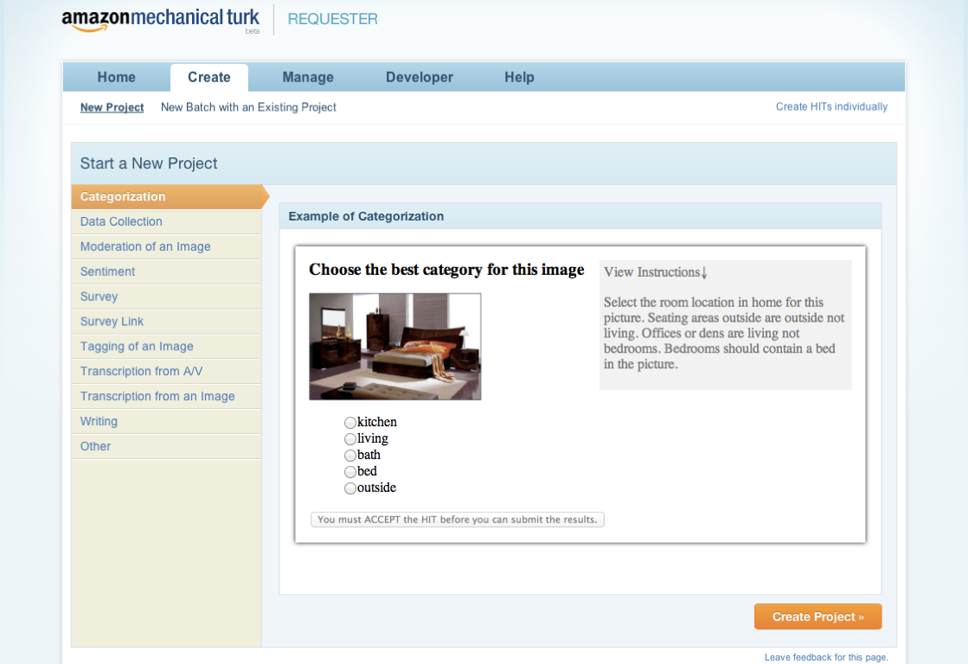

Slide 3
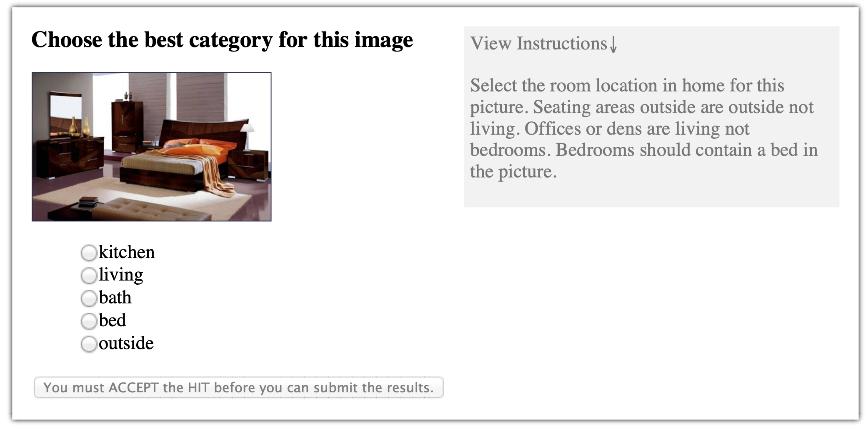
Categorization

Slide 4
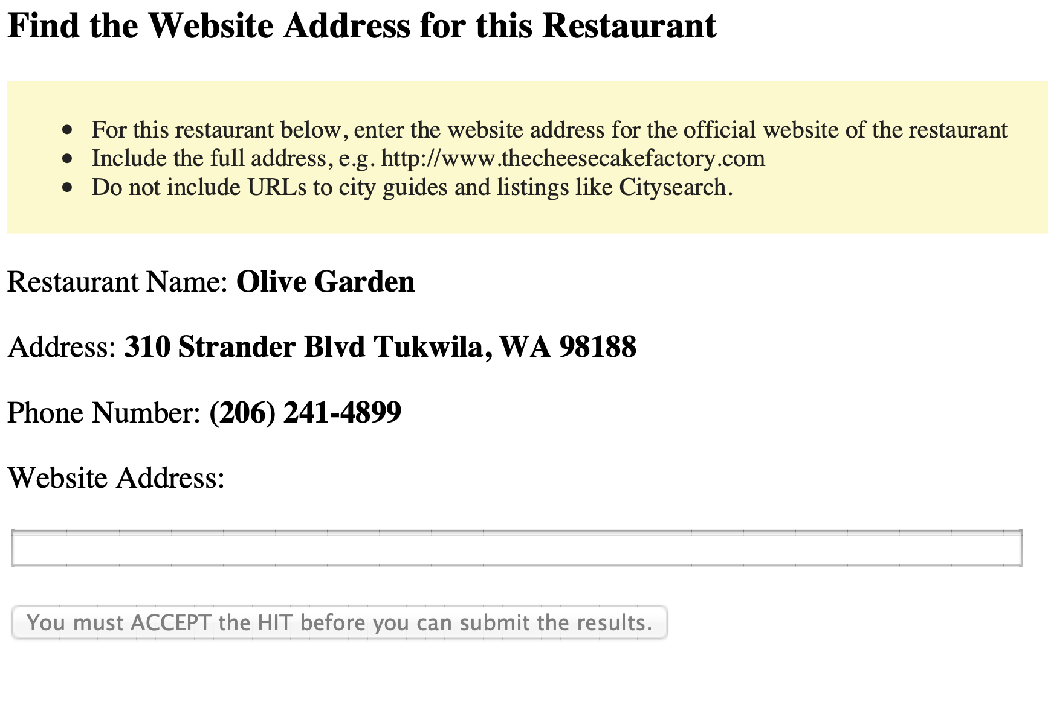
Data Collection

Slide 5
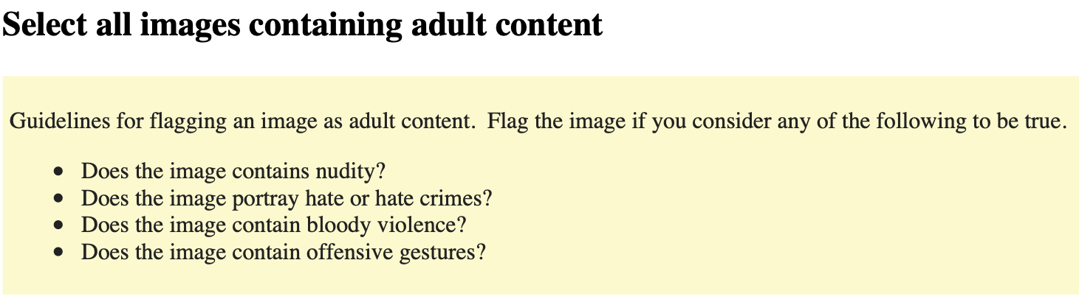
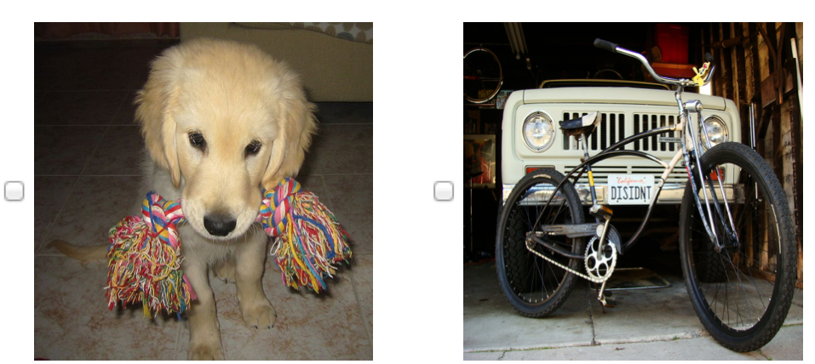
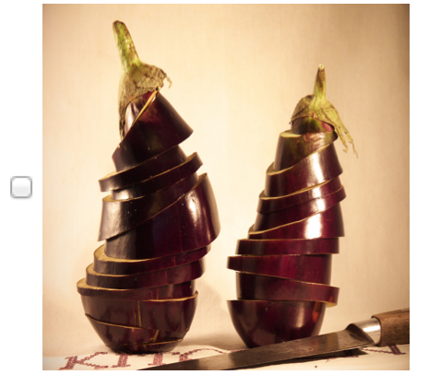
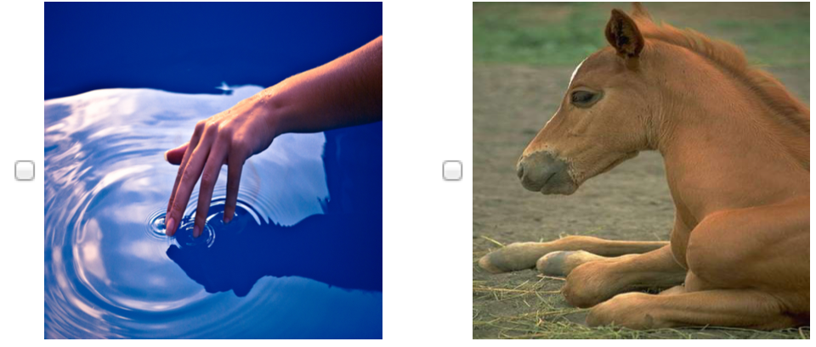
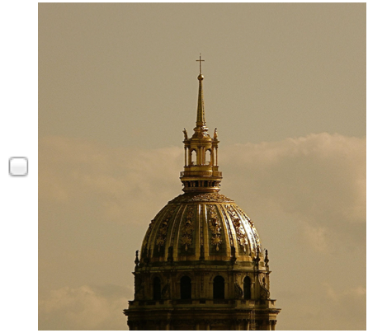
Image Moderation

Slide 6
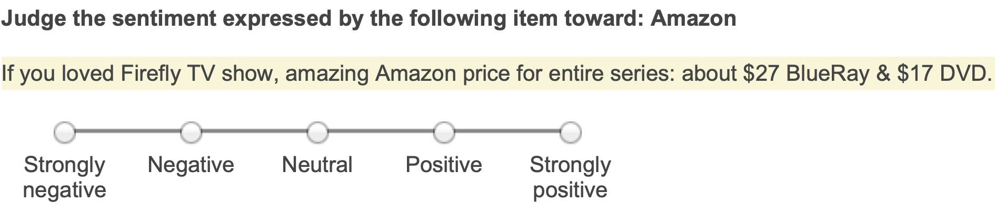
Sentiment
Pick the best sentiment based on the following criterion.
Strongly positive | Select this if the item embodies emotion that was extremely happy or excited toward the topic. For example, "Their customer service is the best that I've seen!!!!"
Positive | Select this if the item embodies emotion that was generally happy or satisfied, but the emotion wasn't extreme. For example, "Sure I'll shop there again."
Neutral | Select this if the item does not embody much of positive or negative emotion toward the topic. For example, "Yeah, I guess it's ok." or "Is their customer service open 24x7?"
Negative | Select this if the item embodies emotion that is perceived to be angry or upsetting toward the topic, but not to the extreme. For example, "I don't know if I'll shop there again because I don't trust them."
Strongly negative | Select this if the item embodies negative emotion toward the topic that can be perceived as extreme. For example, "These guys are teriffic... NOTTTT!!!!!!" or "I will NEVER shop there again!!!"

Slide 7
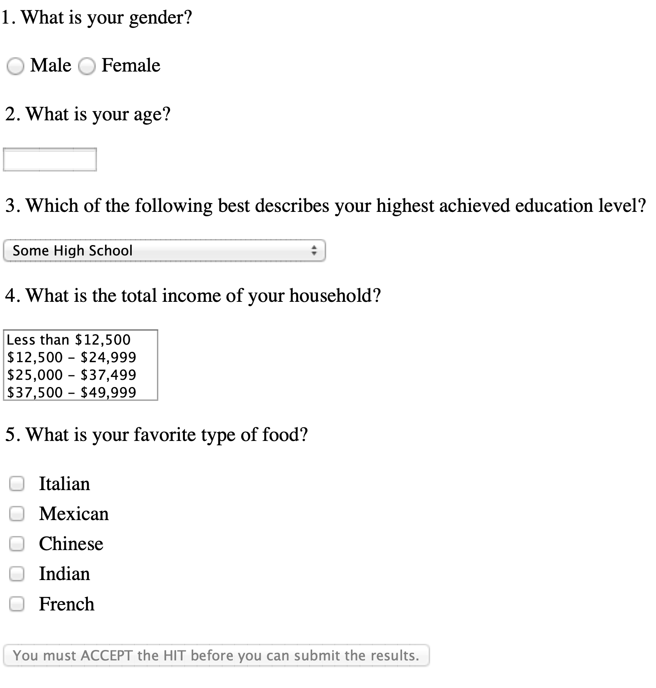
Surveys

Slide 8
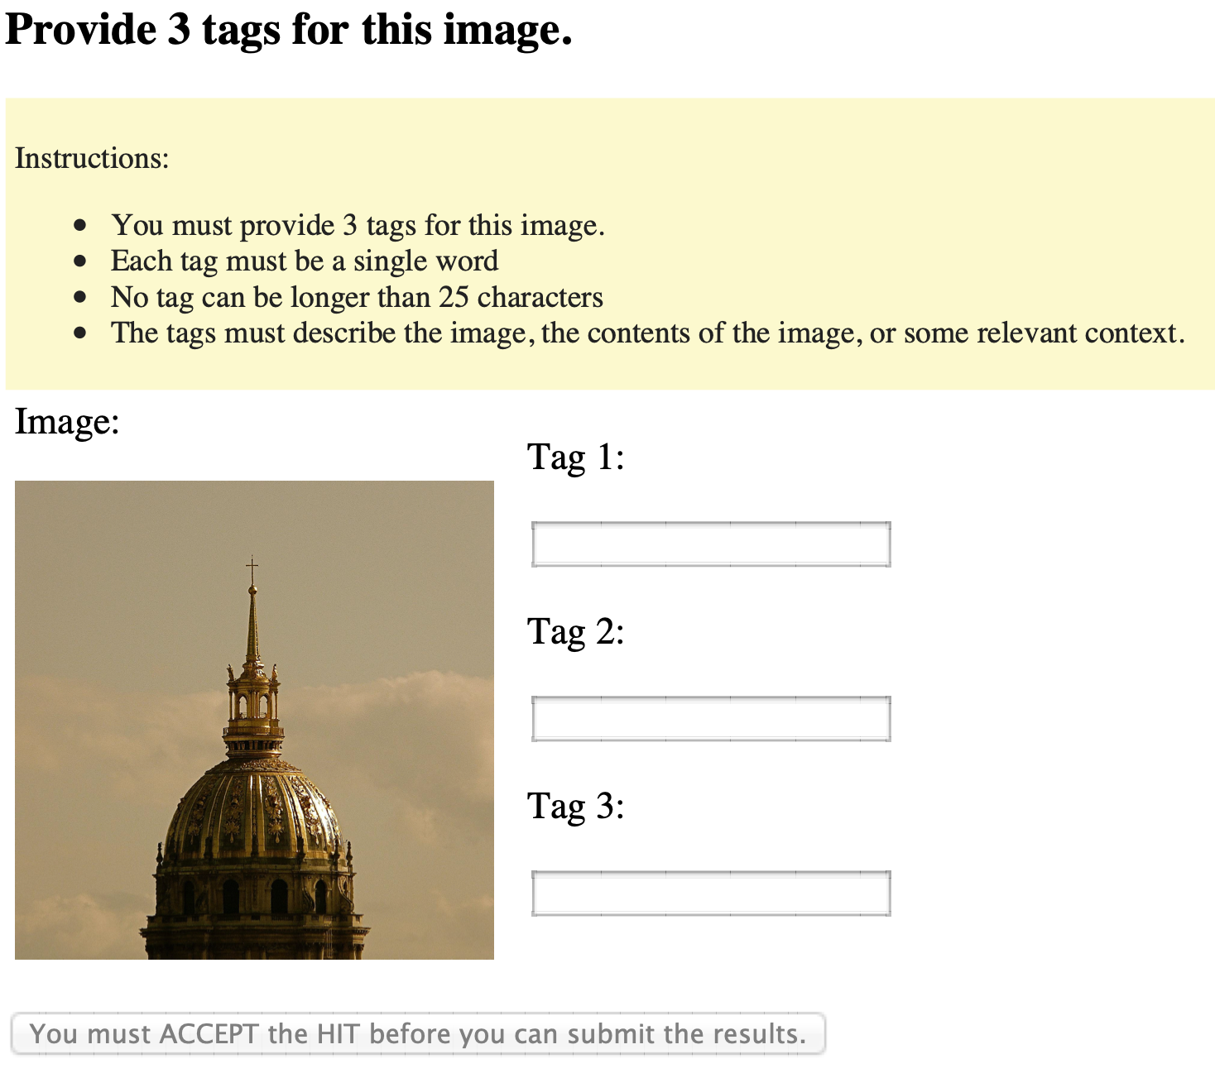
Image tagging

Slide 9
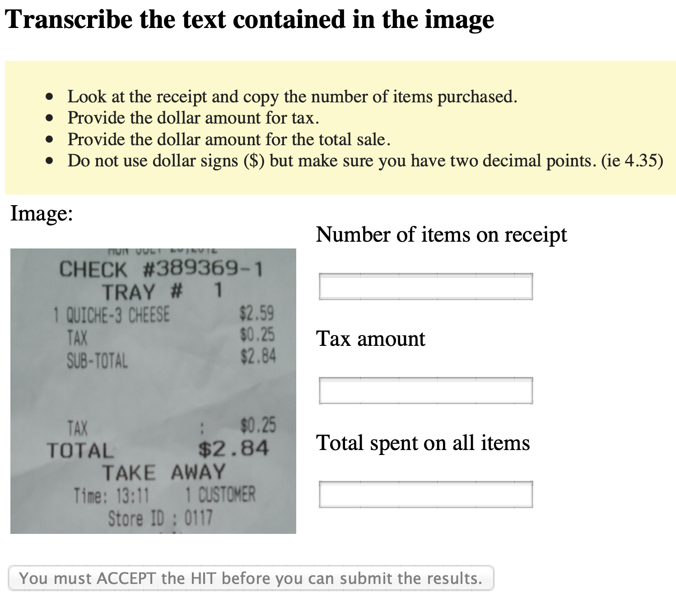
Transcription

Slide 10
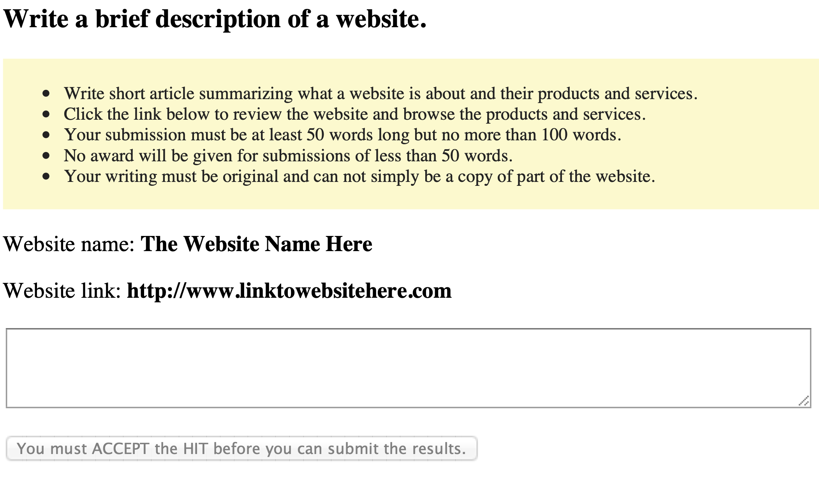
Writing

Slide 11
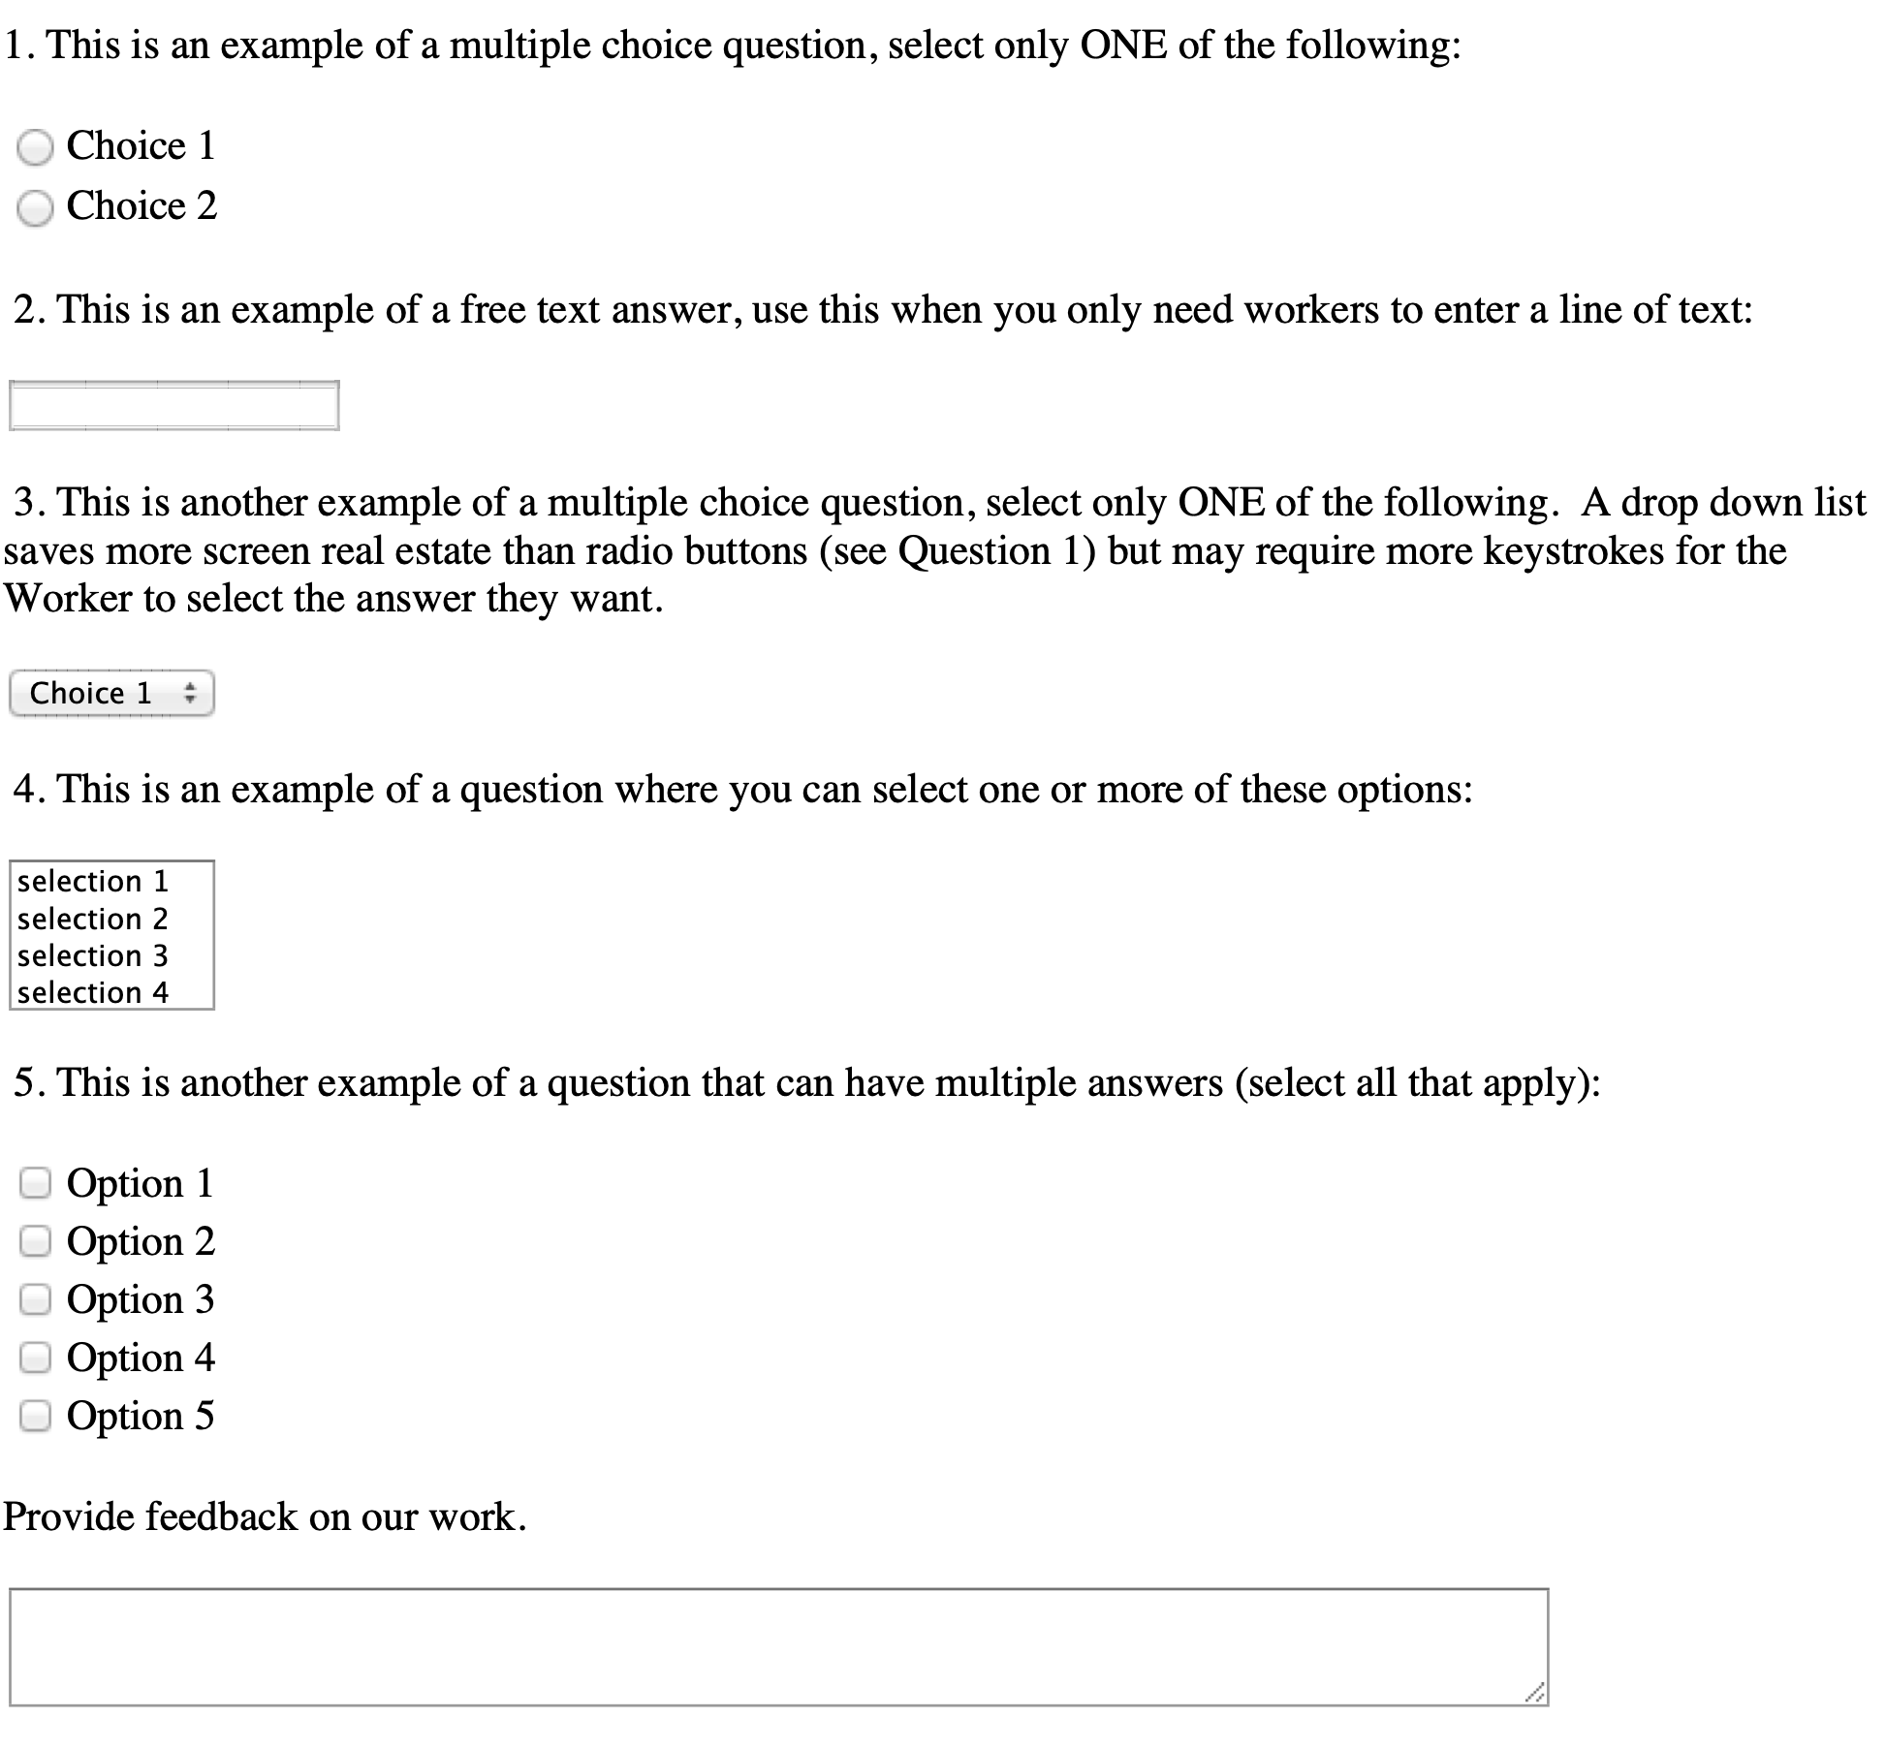
Any HTML form

Slide 12


Slide 13
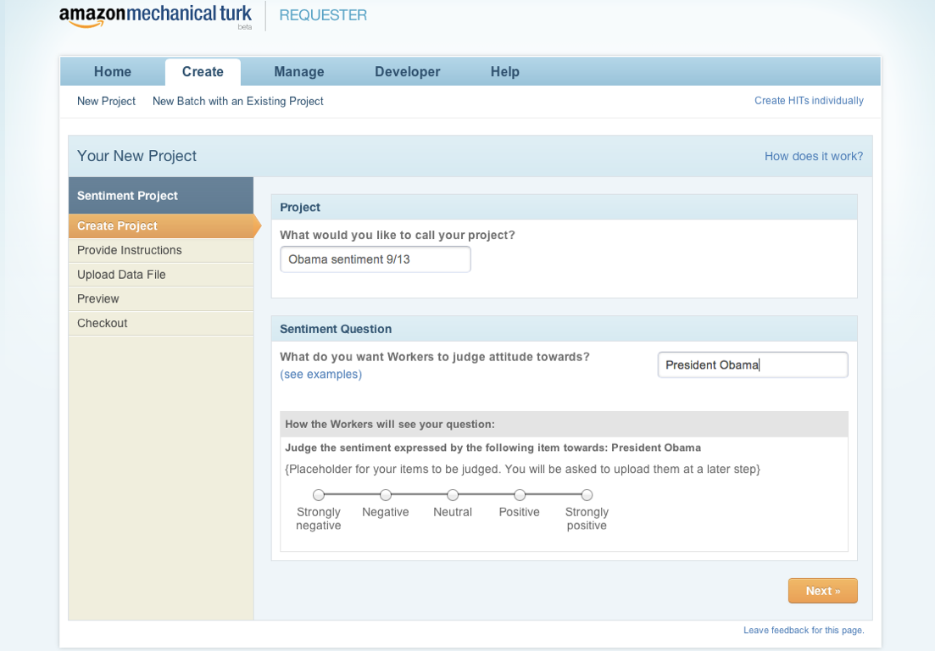

Slide 14
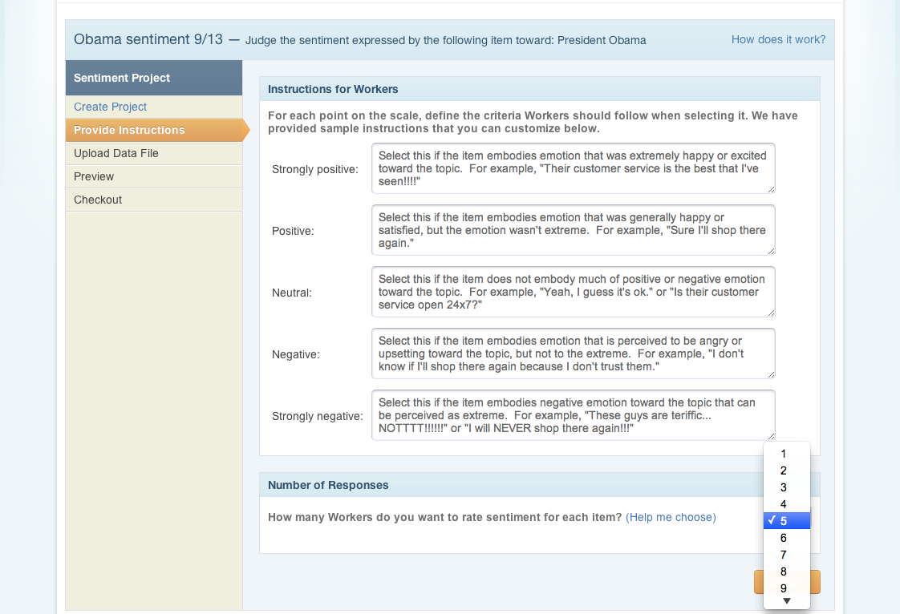

Slide 15
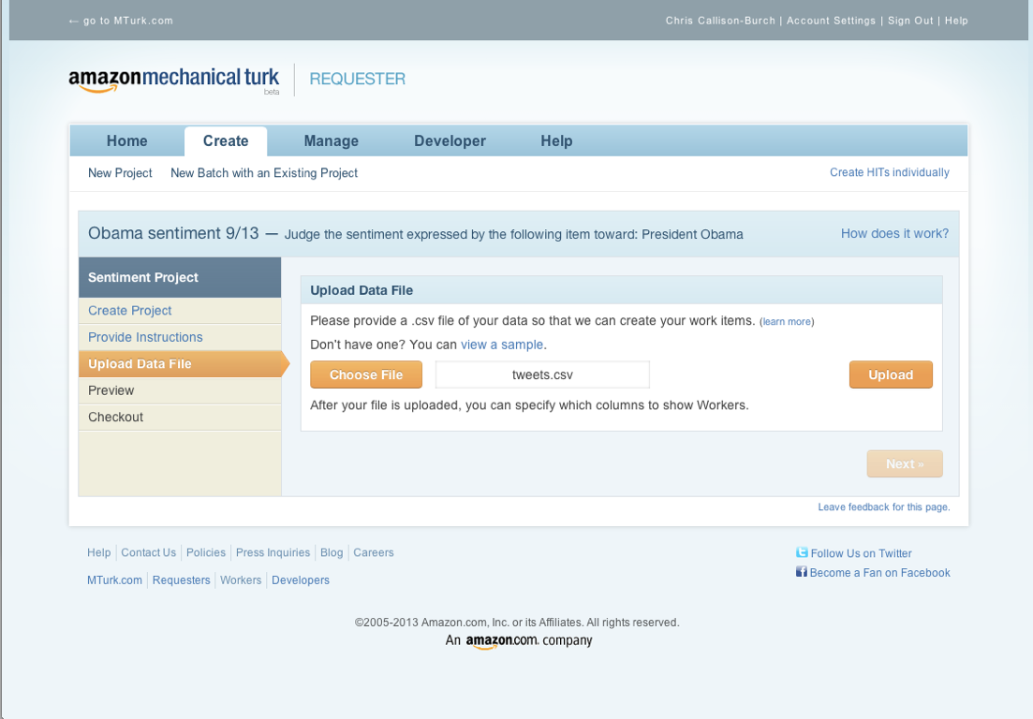

Slide 16
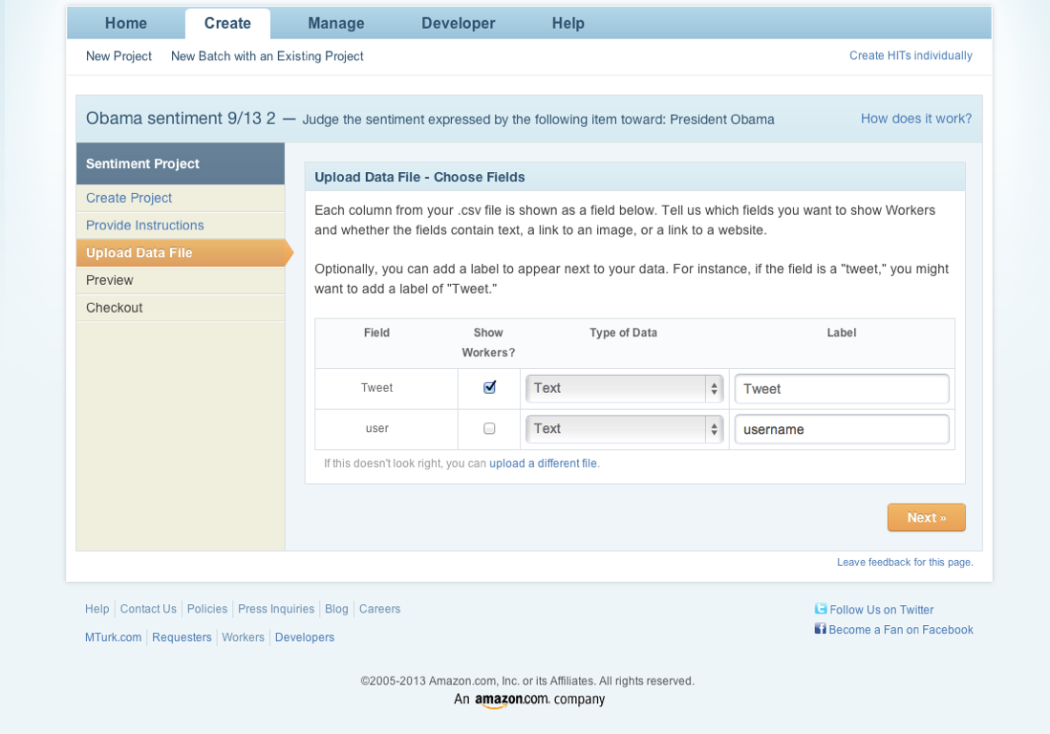

Slide 17
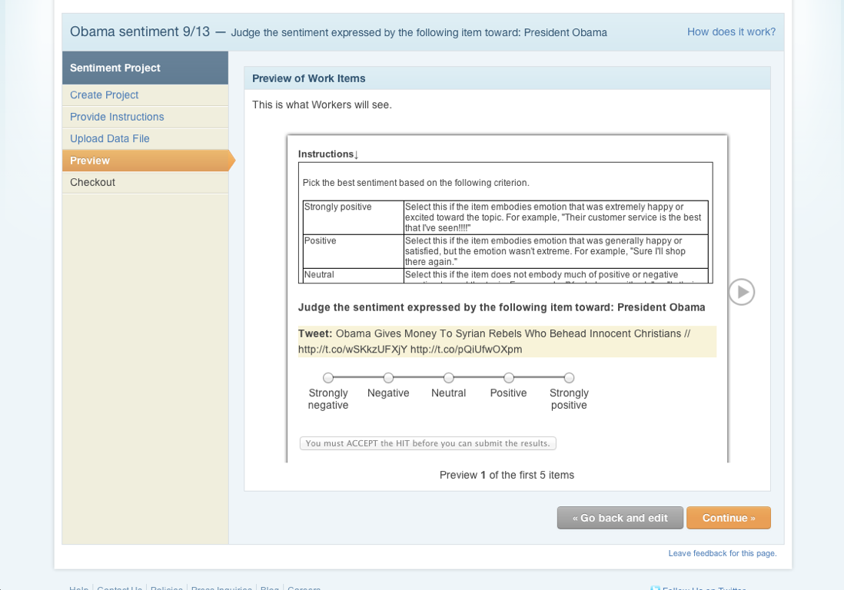

Slide 18
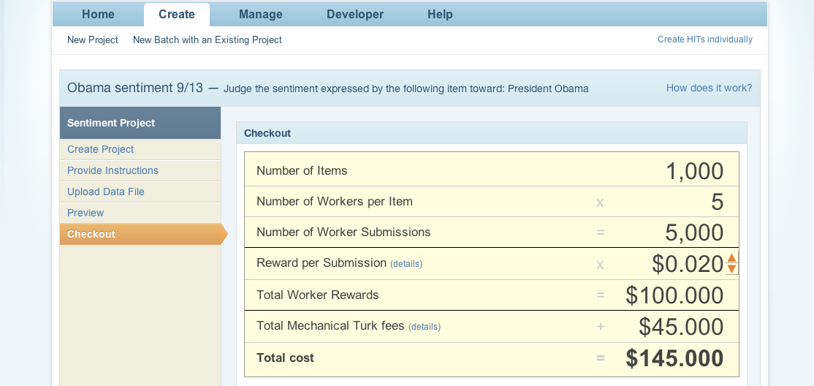

Slide 19
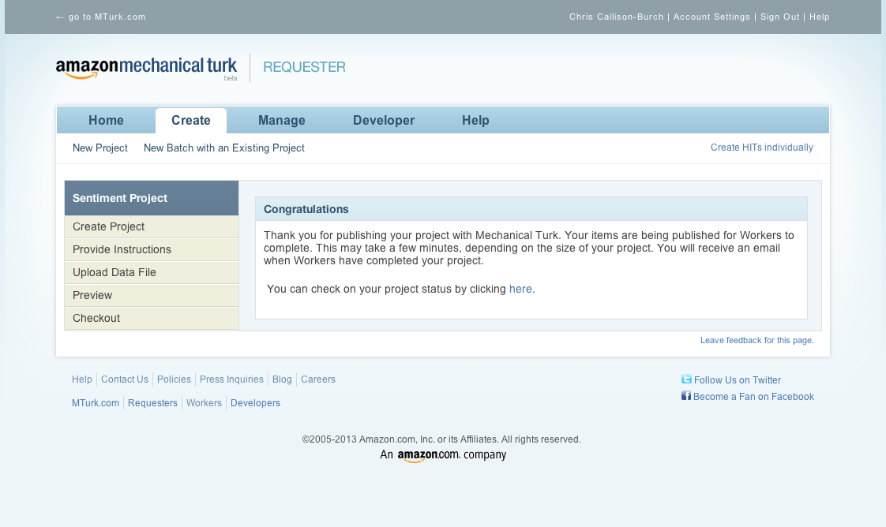

Slide 20
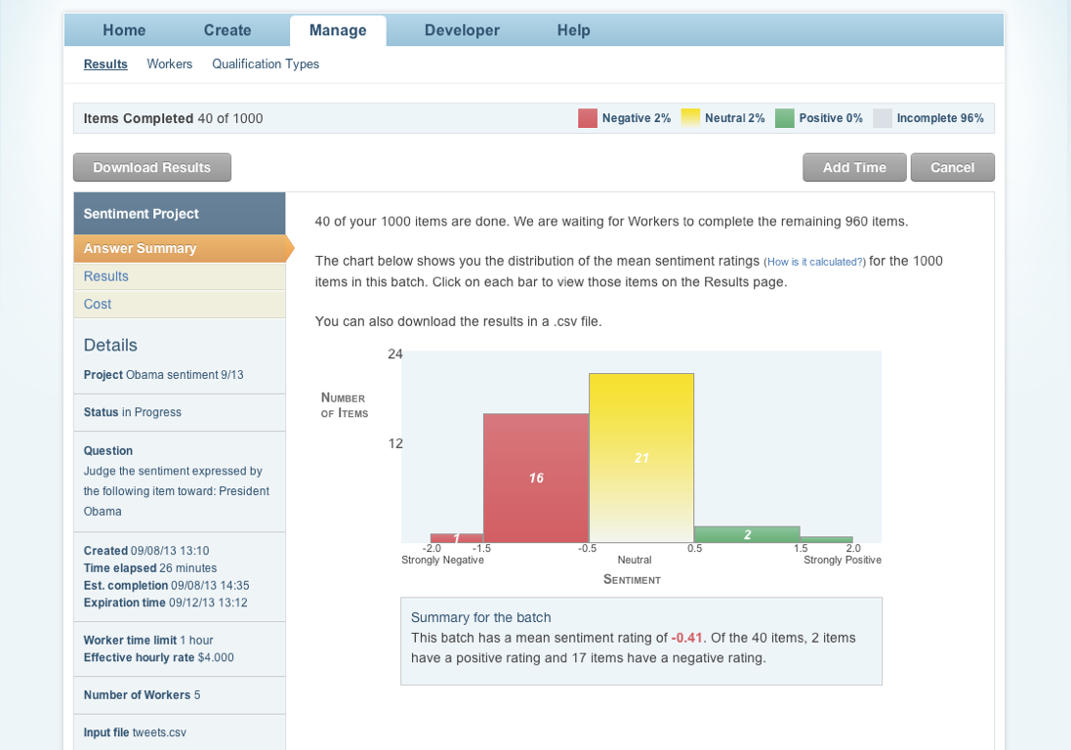

Slide 21
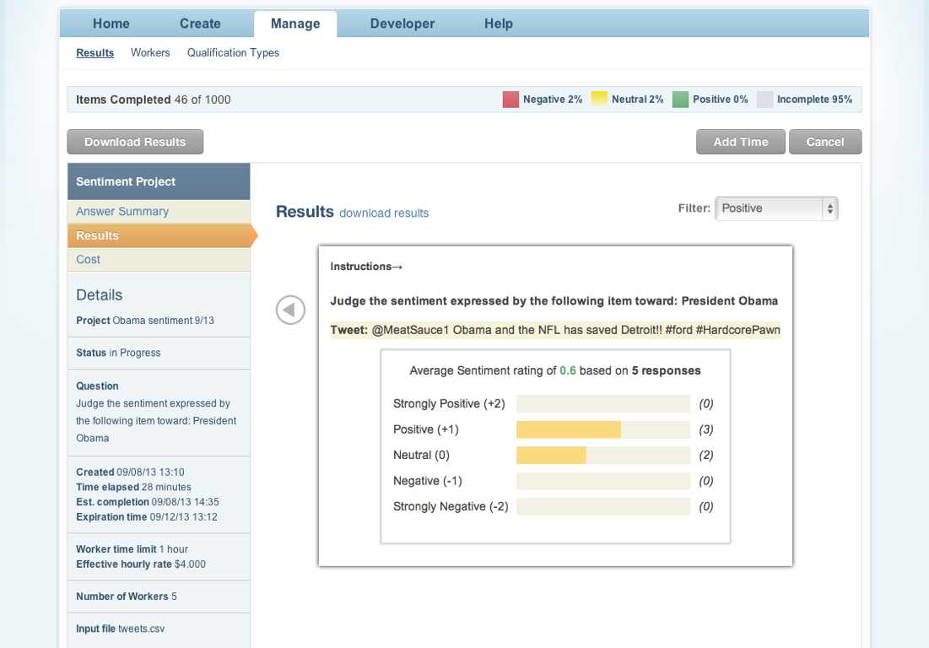

Slide 22
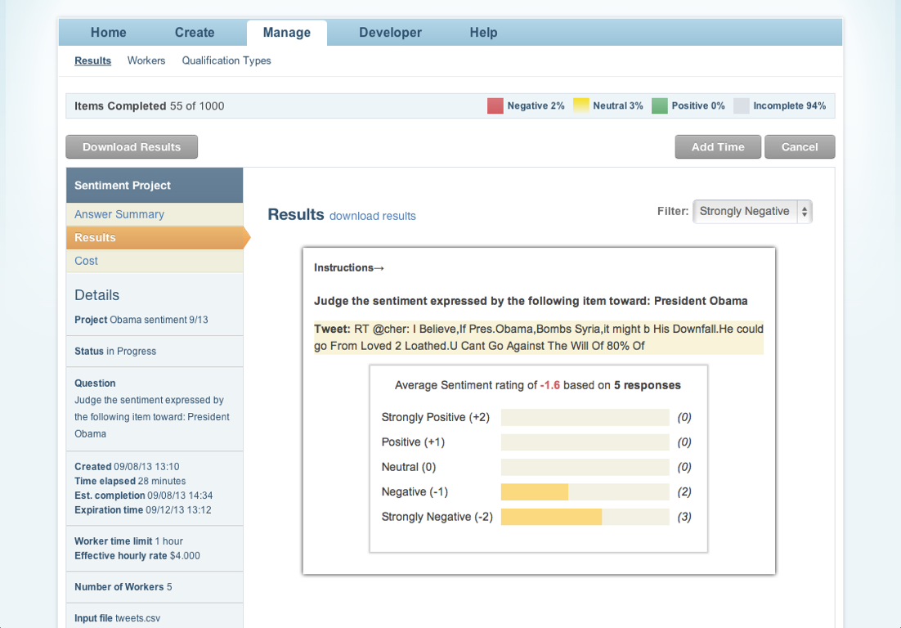

Slide 23
Building your own HIT
Set the parameters of your HIT
Optionally, specify requirements for which Turkers can complete your HIT
Design an HTML template with ${variables}
Upload a CSV file to populate the variables
Pre-pay Amazon for the work
Approve/reject work from Turkers
Analyze results

Slide 24
HIT Parameters
title
description
keywords
reward amount
max time allotted for work
auto approval time

Slide 25
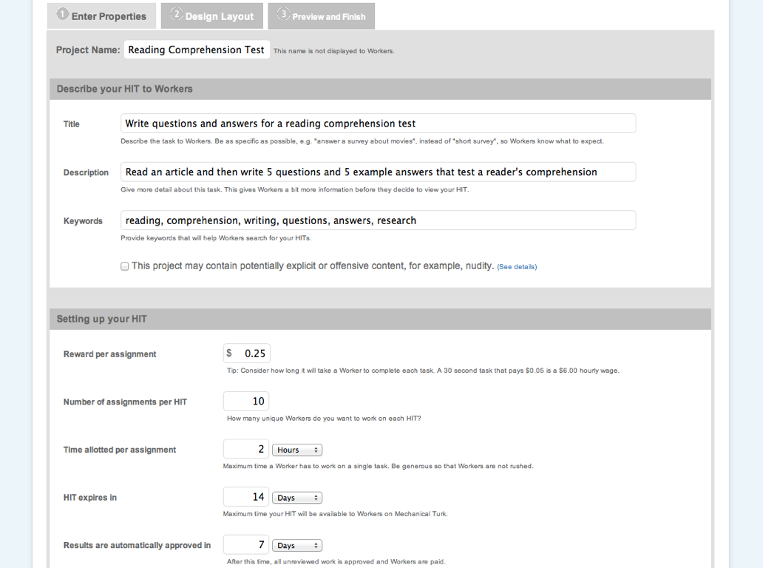

Slide 26
Purpose of redundancy
MTurk lets you set the number of assignments per HIT
That gives you different (redundant) answers from different Turkers
This lets you conduct surveys (num assignments = num respondents)
Also, lets you take votes and do tie-breaking, or do quality control
Redundancy >= 10x incurs higher fees on MTurk

Slide 27
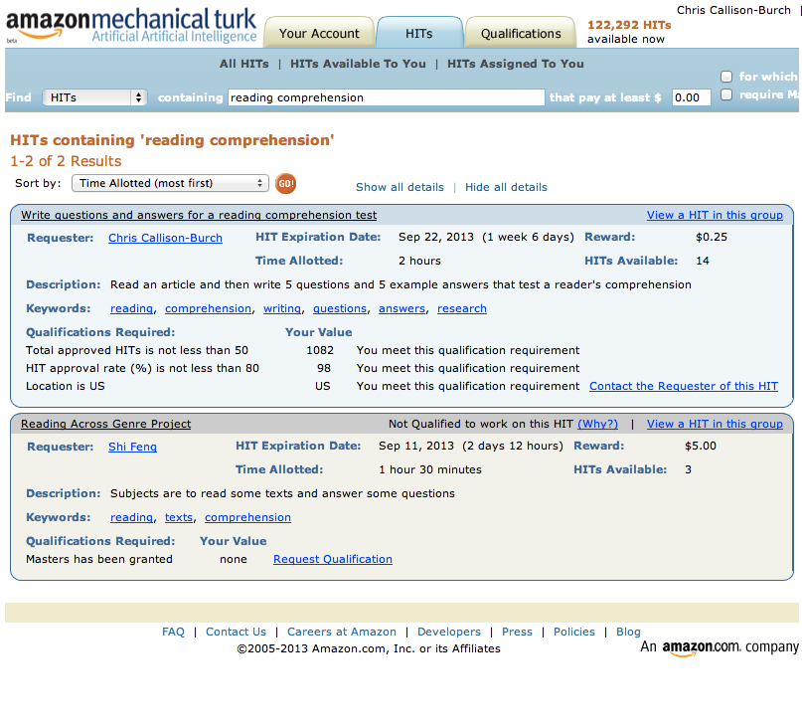

Slide 28
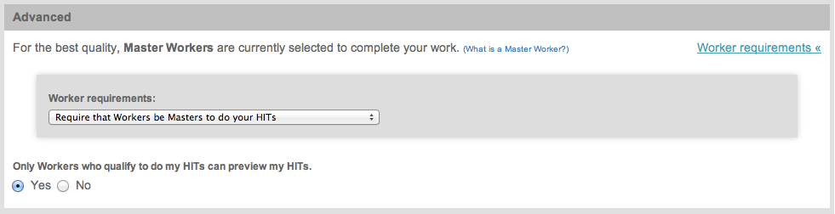
Worker Requirements

Slide 29
Worker Requirements
Location
Past approval rate
Number of HITs completed

Slide 30
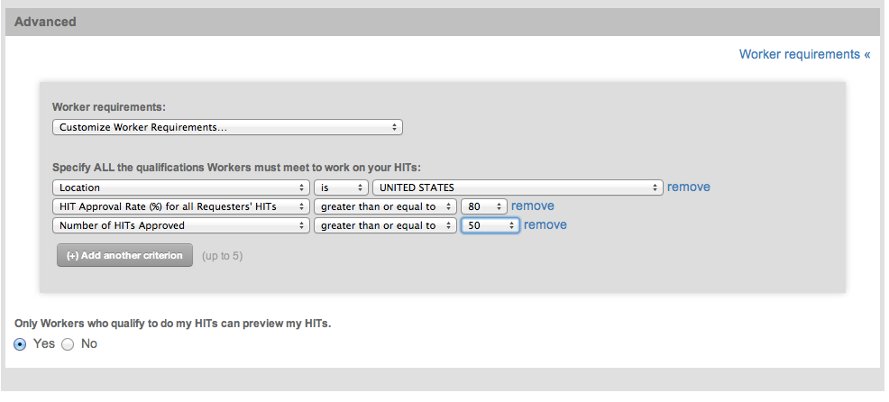
Worker Requirements

Slide 31
Masters
Masters are elite groups of Workers who have demonstrated accuracy on specific types of HITs. Workers achieve a Masters distinction by consistently completing HITs with a high degree of accuracy across a variety of Requesters. Masters must continue to pass our statistical monitoring to remain Mechanical Turk Masters. Because Masters have demonstrated accuracy, they can command a higher reward for their HITs. You should expect to pay Masters a higher reward.
Notes:
https://requester.mturk.com/help/faq#what_are_masters
You can have Masters who have demonstrated accuracy specifically in Data Categorization or Photo Moderation do your HITs, or you can elect to have general Masters perform your HITs. Because

Slide 32
Masters
Amazon now nominates a subset (21k workers, estimated at 10% of all Turkers) of senior / good workers as “Masters”
Amazon charges 25% commission for Masters versus their normal 20% rate
They have now implemented this as the default qualification for new Requesters
Why?
Notes:
http://www.behind-the-enemy-lines.com/2012/12/mechanical-turk-changing-defaults-game.html

Slide 33
Masters: Pros
People who use the Web UI are often newcomers who do not know to implement quality control.
Masters will not touch badly designed and ambiguous tasks.
Masters will not touch tasks paying less than minimum wage.

Slide 34
Masters: Cons
There are many fewer Masters workers.
There is now a significant lag in the task being picked by workers.
The tasks now take much longer to complete.
There is an increased cost because Masters demand decent wages.
It is not clear in what tasks the Masters are tested and how a new worker can become a master.

Slide 35
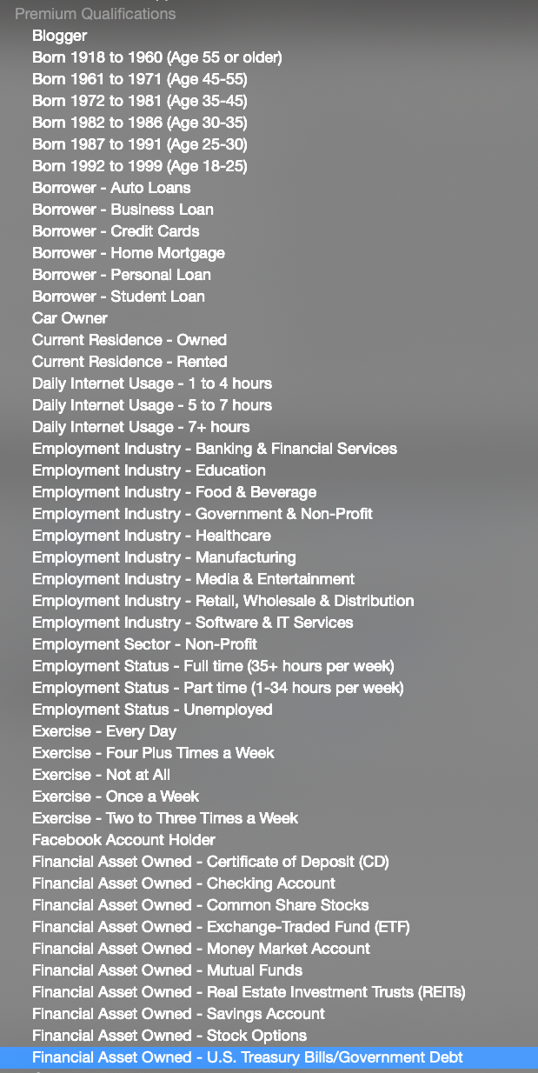
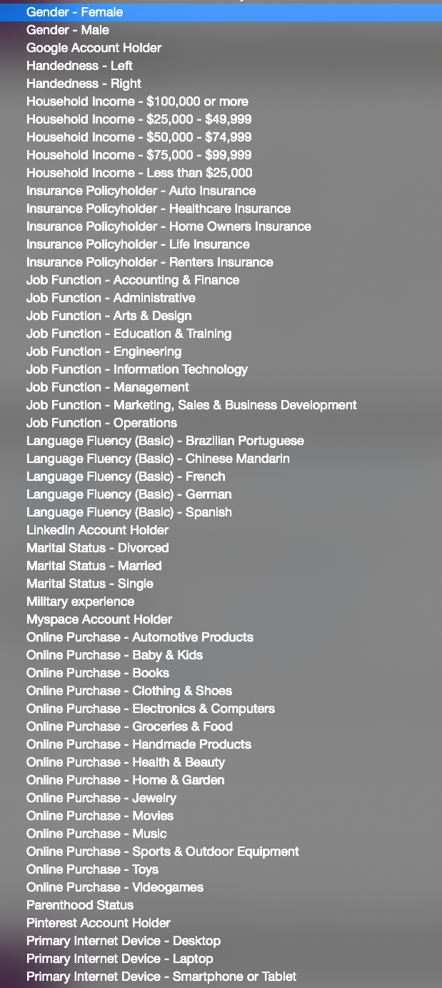
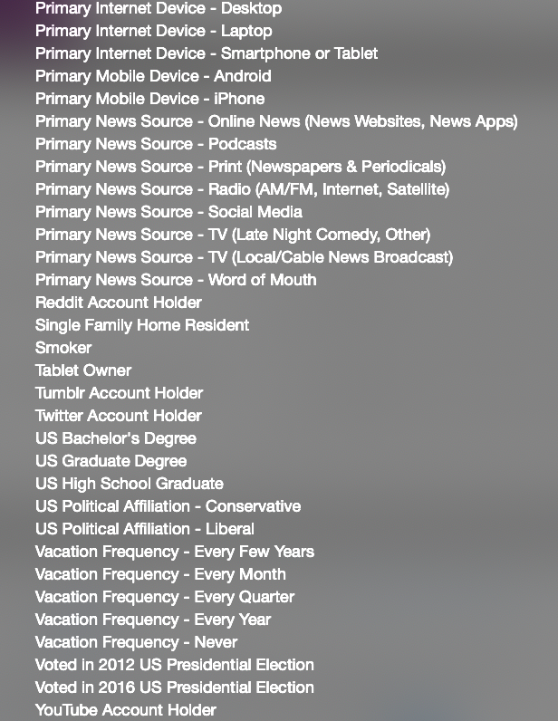
Premium Qualifications

Slide 36
Custom Qualifications
In addition to the built in qualifications (masters, location, approval rate, min HITs completed), you can also create and manage your own qualifications
These can be managed through the web interface or the API

Slide 37
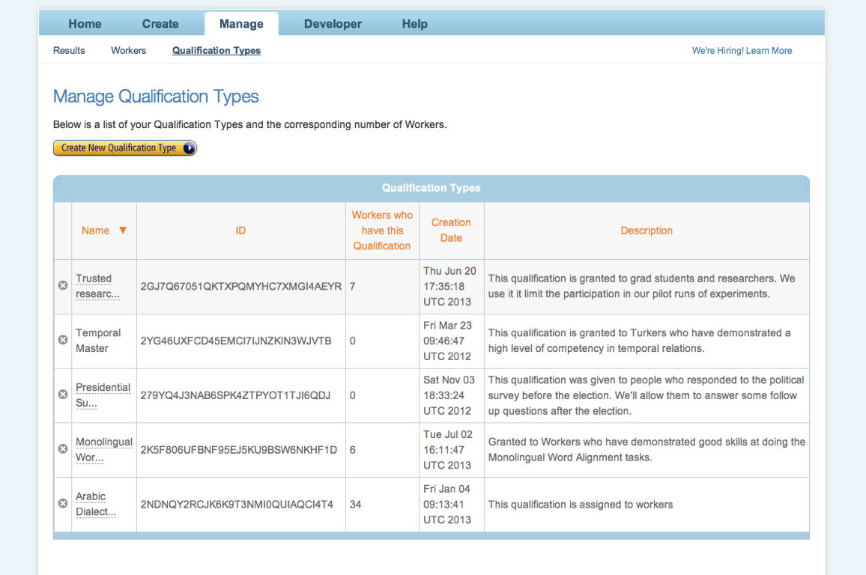
Custom Qualifications

Slide 38
Qualification Tests
The API also allows you to set up qualification tests that Workers must pass before doing your tasks
What effects do you think qualification tests have?
Notes:
* Increases quality
* Reduces participation

Slide 39
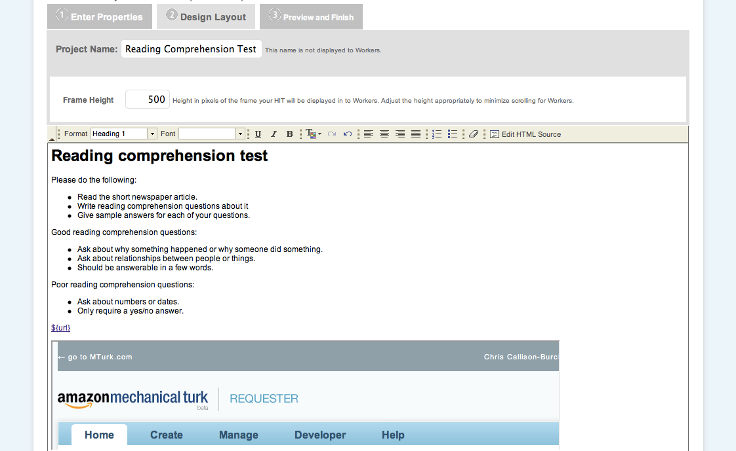
HTML Template

Slide 40
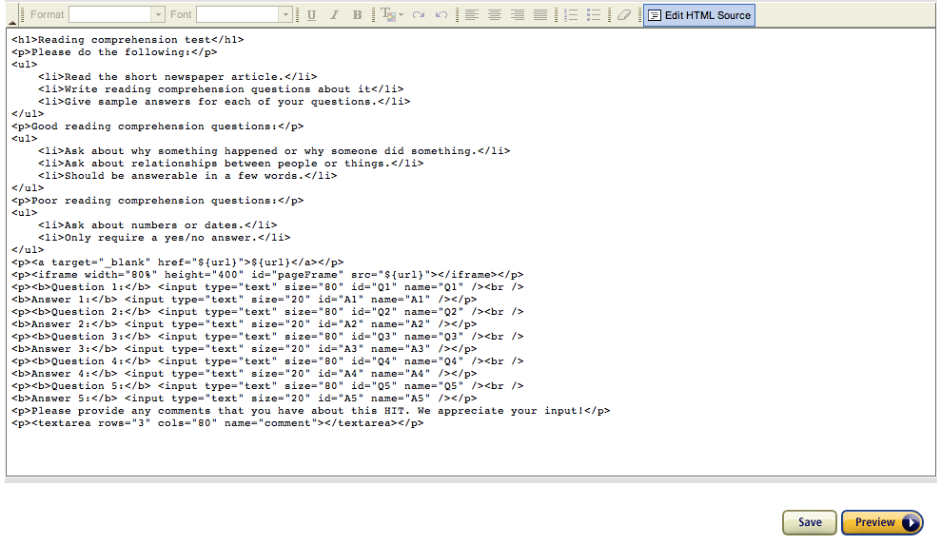
HTML Template

Slide 41
Writing Instructions
Be sure to be as specific as possible in your instructions so that there's no confusion. For example, when asking workers to extract text from an image, ask workers to type the text exactly as shown in the image including capitalizations, spaces and punctuation.
Include an example of a right answer, and a wrong answer
Clarify what you expect if the HIT is not doable because of missing data or other problems

Slide 42
How to populate a HIT with data
Using the web interface, you communicate data with MTurk via Comma Separated Value (CSV) files
Each column header gives a ${variable} name
Each row gives one screen’s worth of data
You may have more columns than are used in the HIT - useful for bookkeeping

Slide 43
Uploading a CSV

Slide 44
Special characters in the CSV spec
There are several special characters that are reserved in the CSV format
I recommend using Python CSV module, or exporting CSV from Excel
HTML reserve characters also need special treatment since the ${variables} get inserted as strings into your template
Also be careful if you’re using javascript

Slide 45
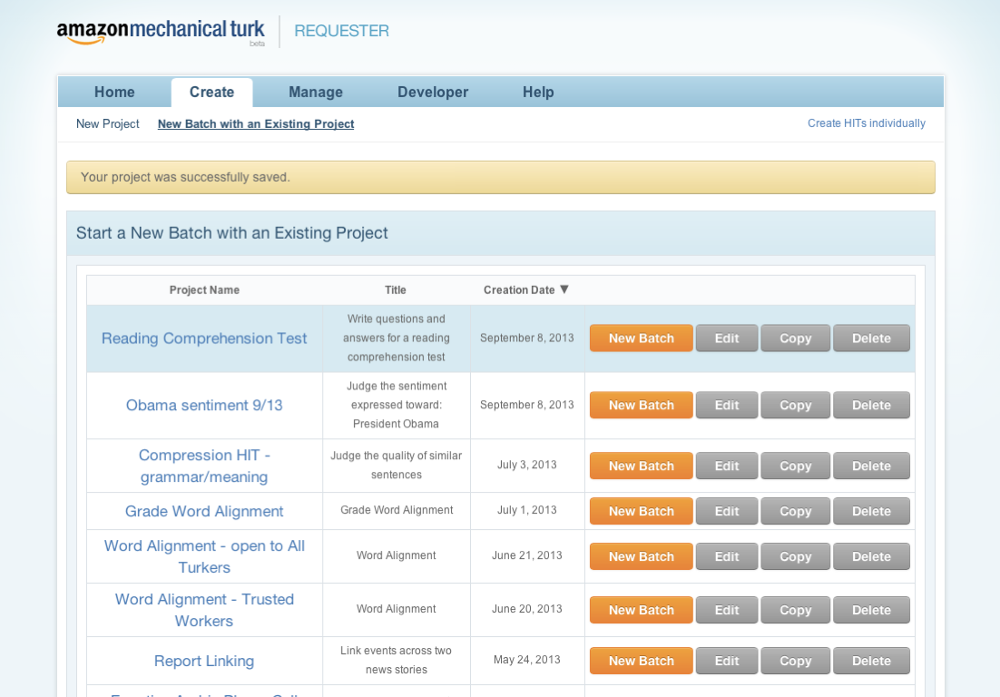

Slide 46
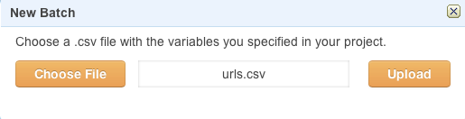

Slide 47
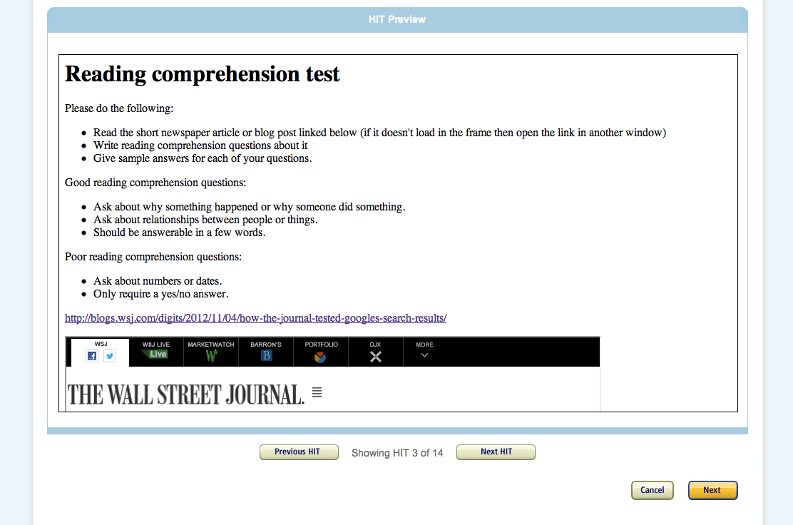

Slide 48
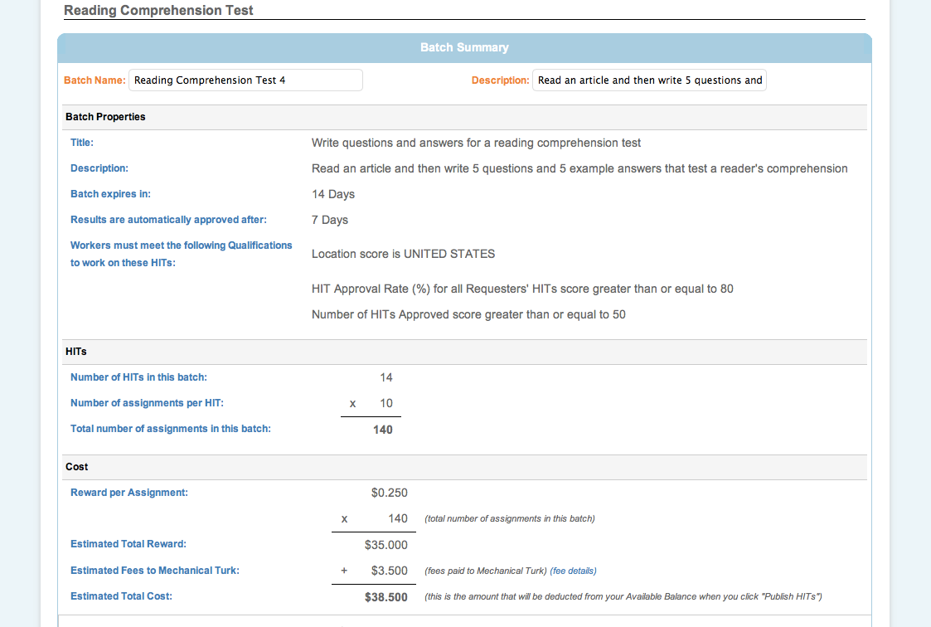

Slide 49
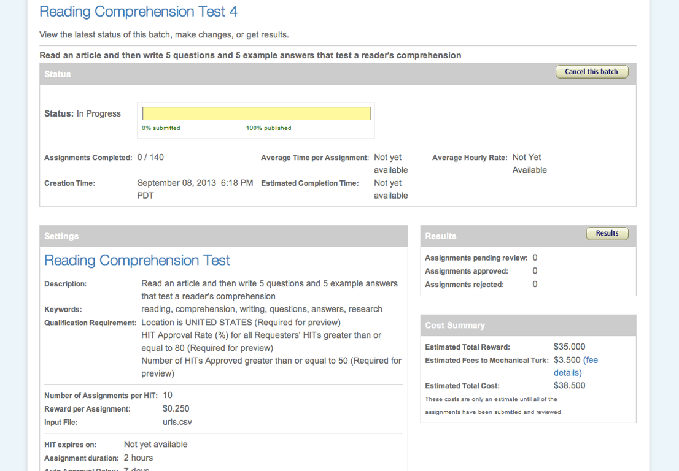

Slide 50
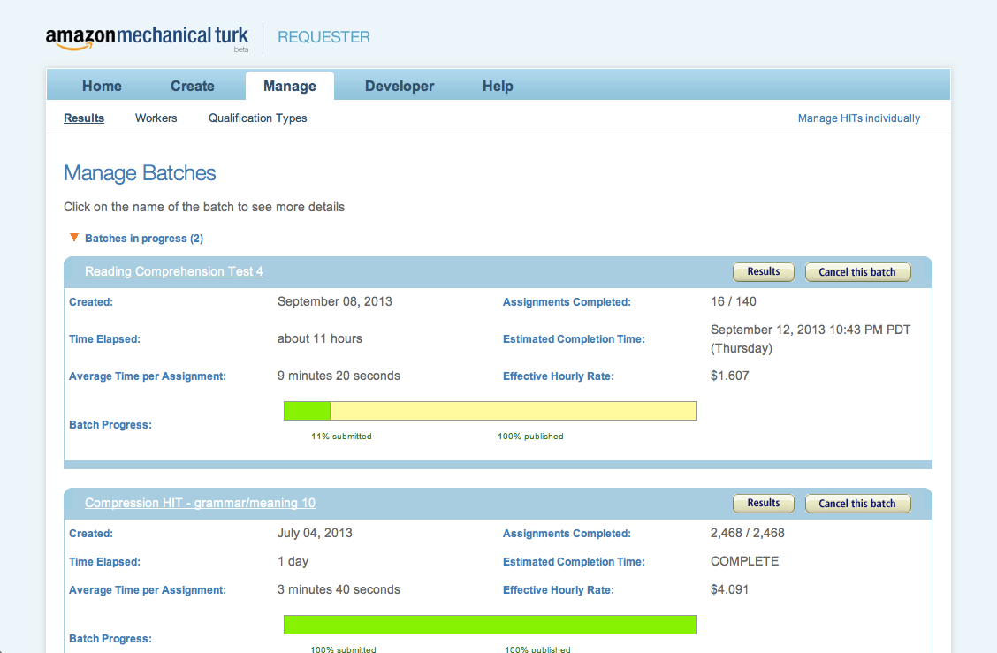

Slide 51
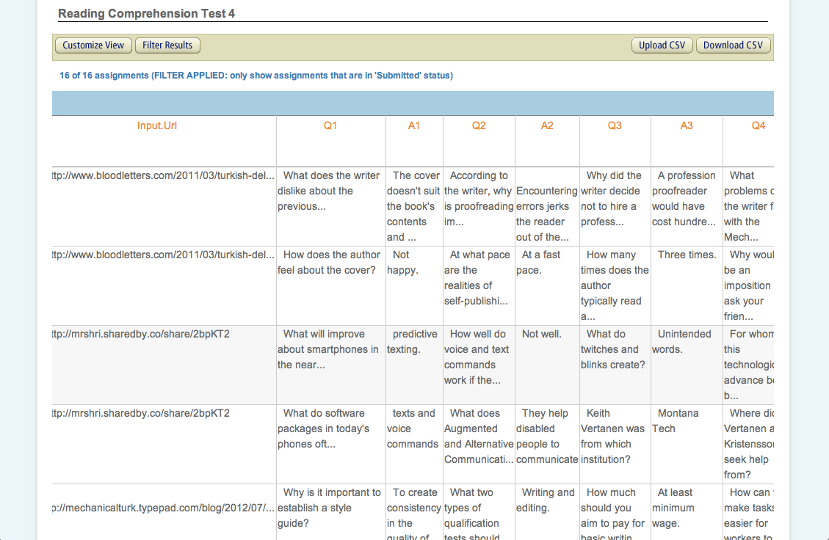

Slide 52
Approving / rejecting
The MTurk web interface gives you a way of manually reviewing the Turkers results
After reviewing a Worker’s submission, you can
approve it (worker gets paid)
reject it (worker does not get paid)
block the worker (worker is banned from working on any of your HITs, and may get blacklisted from MTurk)

Slide 53
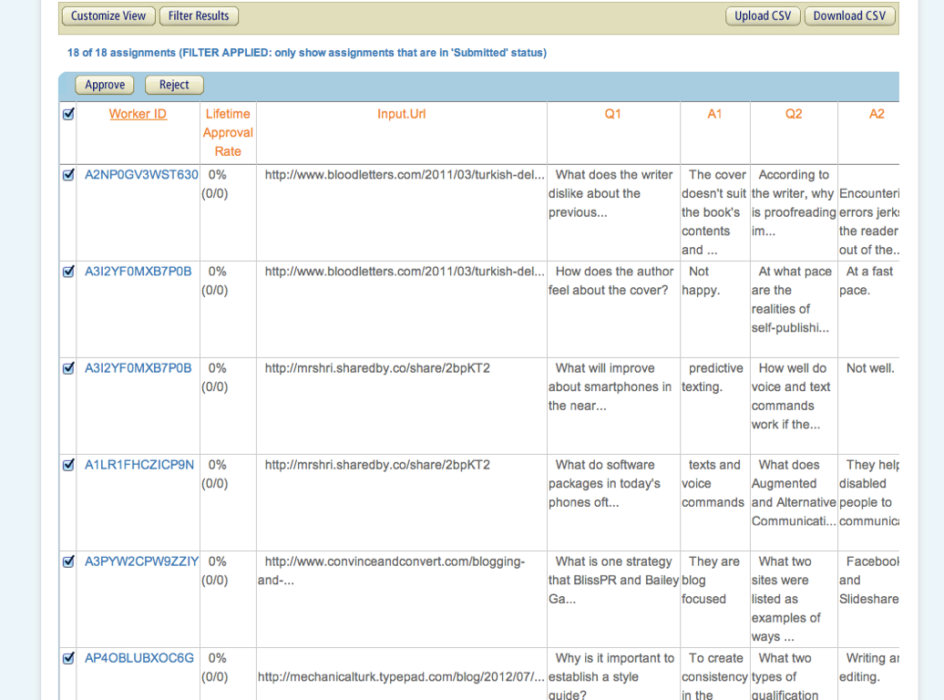

Slide 54
Semi-automating the approval process with CSV
A lightweight version of the API is available by uploading a graded CSV
You can download the results as a CSV file, grade it (manually or automatically), and upload your approve or reject decisions
A quick and easy thing to do if you have a HIT with gold standard controls, and if you learn python’s CSV module

Slide 55
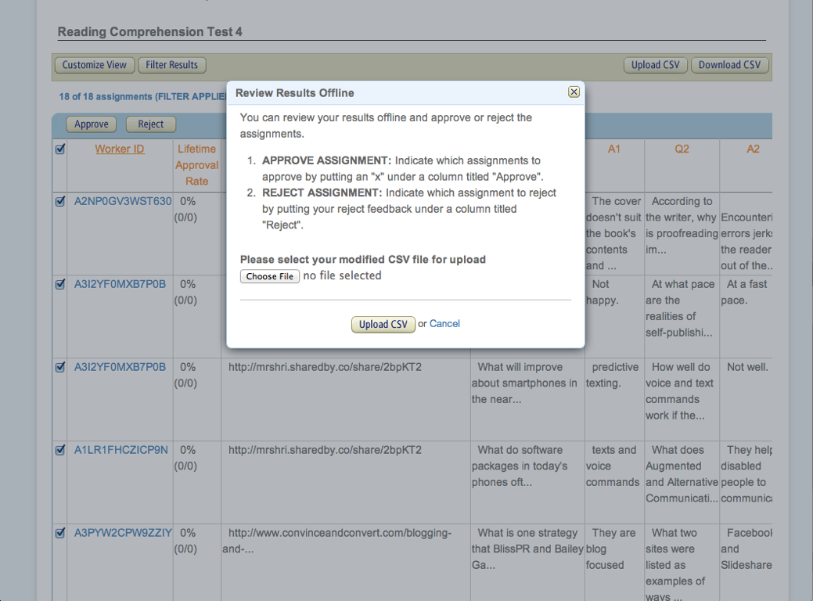

Slide 56
Recommendation for approval thresholds
If using controls to approve/reject assignments automatically, I recommend using 3 values
1) ~80% correct = approve all work from this Turker
2) <80% but >chance = approve assignments proportional to accuracy on the controls
3) <= chance, reject all assignments

Slide 57
The Sandbox
Amazon provides a `sandbox’ where Requesters can develop and deploy HITs at no cost
requestersandbox.mturk.com mimics the behavior of requester.mturk.com
When you post to the requestersandbox the HITs become available on workersandbox.mturk.com

Slide 58


Slide 59
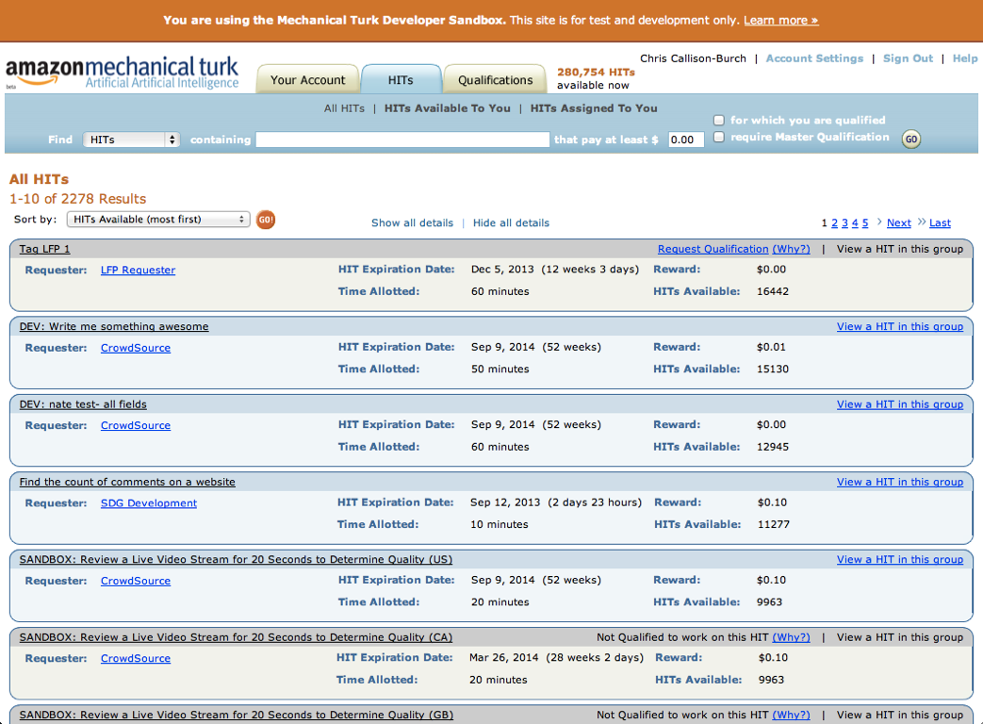

Slide 60
HITs can use any HTML or javascript
Highlight word in sentence
Word alignment HIT
Randomize order of things
Geolocation

Slide 61
The MTurk SDK

Slide 62
The art of designing good HITs

Slide 63
Crowdsourcing works for tasks that are
Natural and easy to explain to non-experts
Decomposable into simpler tasks that can be joined together
Parallelizable into small, quickly completed chunks
Well-suited to quality control (some data has correct gold standard annotations)

Slide 64
Crowdsourcing works for tasks that are
Robust to some amount of noise/errors (the downstream task is training a statistical model)
Balanced and each task contains the same amount of work
Don’t have tons of work in one assignment but not another
Don’t ask Turkers to annotate something occurs in the data <<10% of the time

Slide 65
Example HIT design:
Reading Comprehension to evaluate Machine Translation systems

Slide 66
Evaluating Machine Translation
There are many MT systems available for each language pair
How do we know which one is best?
There is an active field of research focused on evaluating MT automatically
Reasoning: manual evaluation requires humans and is therefore too time consuming and expensive

Slide 67
Evaluating Machine Translation
I designed a pipelined HIT
First take foreign articles translated into English
Have Turkers write reading compre

Slide 68
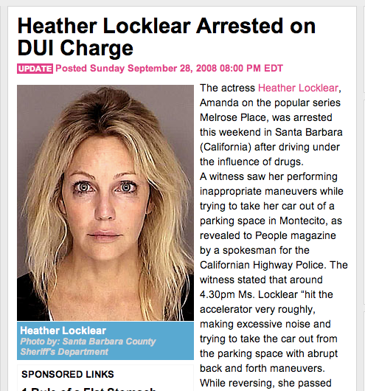
Heather Locklear Arrested for
driving under the influence of drugs
Why was Heather Locklear arrested?
She was arrested on suspicion of driving under the influence of drugs.
Why did the bystander call emergency services?
He was concerned for Ms. Locklear’s life.
Where did the witness see her acting abnormally?
Pulling out of parking in Montecito
The actress Heather Locklear, Amanda of the popular series Melrose Place, was arrested this weekend in Santa Barbara (California) after driving under the influence of drugs. A witness viewed her performing inappropriate maneuvers while trying to take her car out from a parking in Montecito, as revealed to People magazine by a spokesman for the Californian Highway Police. The witness stated that around 4.30pm Ms. Locklear "hit the accelerator very violently, making excessive noise while trying to take her car out from the parking with abrupt back and forth maneuvers. While reversing, she passed several times in front of his sunglasses." Shortly after, the witness, who, in a first time, apparently had not recognized the actress, saw Ms. Locklear stopping in a nearby street and leaving the vehicle.

Slide 69
Why was Heather Locklear arrested in Montecito?
Because she was driving under the influence of drugs
Where was Locklear arrested?
In a parking lot in Montecito
Why was Heather Locklear arrested?
She was arrested on suspicion of driving under the influence
Why was Heather Locklear arrested in Montecito?
Because she was driving under the influence of drugs
What was Heather Locklear arrested for?
Driving under the influence of drugs

Slide 70
Was arrested actress Heather Locklear because of the driving under the effect of an unknown medicine
Heather Locklear Arrested for
driving under the influence of drugs
Why was Heather Locklear arrested?
Why did the bystander call emergency services?
Where did the witness see her acting abnormally?
The actress Heather Locklear that is known to the Amanda through the role from the series "Melrose Place" was arrested at this weekend in Santa Barbara (Californium) because of the driving under the effect of an unknown medicine. A female witness observed she attempted in quite strange way how to go from their parking space in Montecito, speaker of the traffic police of californium told the warehouse `People'. The female witness told in detail, that Locklear 'pressed `after 16:30 clock accelerator and a lot of noise did when she attempted to move their car towards behind or forward from the parking space, and when it went backwards, she pulled itself together unites Male at their sunglasses'. A little later the female witness that did probably not have Anfangs the actress Erkannt saw that Locklear stopped on a street seemed likely and the car got out.
Driving while medicated
The actress Heather Locklear, Amanda of the popular series Melrose Place, was arrested this weekend in Santa Barbara (California) after driving under the influence of drugs. A witness viewed her performing inappropriate maneuvers while trying to take her car out from a parking in Montecito, as revealed to People magazine by a spokesman for the Californian Highway Police. The witness stated that around 4.30pm Ms. Locklear "hit the accelerator very violently, making excessive noise while trying to take her car out from the parking with abrupt back and forth maneuvers. While reversing, she passed several times in front of his sunglasses." Shortly after, the witness, who, in a first time, apparently had not recognized the actress, saw Ms. Locklear stopping in a nearby street and leaving the vehicle.
There was a lot of noise
In a parking lot

Slide 71
Was arrested actress Heather Locklear because of the driving under the effect of an unknown medicine
Heather Locklear Arrested for
driving under the influence of drugs
Actress Heather Locklear was due to driving under the influence of an unknown drug arrested
. Medikamentes unknown have the effect of a fahrens under actress heather locklear arrested
Why was Heather Locklear arrested?
Why did the bystander call emergency services?
Where did the witness see her acting abnormally?
The actress Heather Locklear that is known to the Amanda through the role from the series "Melrose Place" was arrested at this weekend in Santa Barbara (Californium) because of the driving under the effect of an unknown medicine. A female witness observed she attempted in quite strange way how to go from their parking space in Montecito, speaker of the traffic police of californium told the warehouse `People'. The female witness told in detail, that Locklear 'pressed `after 16:30 clock accelerator and a lot of noise did when she attempted to move their car towards behind or forward from the parking space, and when it went backwards, she pulled itself together unites Male at their sunglasses'. A little later the female witness that did probably not have Anfangs the actress Erkannt saw that Locklear stopped on a street seemed likely and the car got out.
Actress Heather Locklear, by the role of Amanda from the series "Melrose Place" is known, was this weekend in Santa Barbara (California) because of driving under the influence of an unknown drug arrested. A witness had observed how it quite strange way tried to park their extended gap in Montecito, reported spokesman for the traffic police from California to the magazine `People '. The witness told in detail that Locklear `after 16:30 clock durchdrückte pedal and a lot of noise made by trying to her car to the rear or front of the park gap to move, and when she went backwards, took it a few times in their Sunglass'. Somewhat later the witness saw the beginning of the actress probably had not recognized that Locklear on a nearby road and stopped the car exit.
The witness was the person who notified the emergency service because they fear for `live Locklear had '. When the police patrol arrived, they found the actress in her car seat, which is across the street to stand and thus blocked the traffic. `They seemed to be disoriented, so they brought the policemen into a special drug and alcohol center, a test to make. According to a police spokesman, showed the actress cooperatively, excessive alcohol consumption was from the first moment excluded. `The first observations of officials to follow, we believe that Locklear under the influence of an unknown drug was' said the spokesman. Locklear was under suspicion, under the influence of an unspecified substance to drive, which could not be determined, and arrested to 19 clock in a local trial brought. Two months ago was after treatment Locklaer from the clinic in Arizona dismissed, where it against anxiety and depression was treated.
In Santa. One is, melrose place the series of the role of the 'remember the locklear actress the heather this weekend, because of the fahrens Barbara (California) in effect unknown medikamentes arrested People 'magazine. The traffic police California, spokesman for the auszufahren montecito reported in its way from tried parklücke type strange right, you have seen as a witness. . In some Zeitung, as and when they tried to a great deal of 30 p.m., witness the detail of history locklear after 16: that durchdrückte peddle noise and its progress was made parklücke for the car or moving backwards, they had they times of their sonnenbrille ' . The first was probably recognised that locklear a nearby road and anhielt, had not, with the witness to the car off
Life. 'fear, benachrichtigte the Helpline witness the person that was because they had the locklears'. . Transport and the polizeistreife in her car, with the had, that it was the right road which blocked the '. That is why a test, a special alkoholzentrum in drugs and the police officers have you be', it seemed to orientierungslos According to a polizeisprecher was cooperative, spokesman for alcohol. The first was to present medikamentes first unknown in locklear we believe, as a result of the civil servants, the observation that the 'influence of a', as has been excluded from the with the excessive. Locklear. In p.m. against arrested, not to be the general substance, under the influence of suspected was a local custody and 19 . Locklaer treated months a released from the hospital in Arizona, where it was against treatment after two angstzustände and depression was before
The actress Heather Locklear, Amanda of the popular series Melrose Place, was arrested this weekend in Santa Barbara (California) after driving under the influence of drugs. A witness viewed her performing inappropriate maneuvers while trying to take her car out from a parking in Montecito, as revealed to People magazine by a spokesman for the Californian Highway Police. The witness stated that around 4.30pm Ms. Locklear "hit the accelerator very violently, making excessive noise while trying to take her car out from the parking with abrupt back and forth maneuvers. While reversing, she passed several times in front of his sunglasses." Shortly after, the witness, who, in a first time, apparently had not recognized the actress, saw Ms. Locklear stopping in a nearby street and leaving the vehicle.

Slide 72
Heather Locklear Arrested for
driving under the influence of drugs
Was arrested actress Heather Locklear because of the driving under the effect of an unknown medicine
Why was Heather Locklear arrested?
She was arrested on suspicion of driving under the influence of drugs.
Heather Locklear Arrested for
driving under the influence of drugs
Actress Heather Locklear was due to driving under the influence of an unknown drug arrested
. Medikamentes unknown have the effect of a fahrens under actress heather locklear arrested
The actress Heather Locklear that is known to the Amanda through the role from the series "Melrose Place" was arrested at this weekend in Santa Barbara (Californium) because of the driving under the effect of an unknown medicine. A female witness observed she attempted in quite strange way how to go from their parking space in Montecito, speaker of the traffic police of californium told the warehouse `People'. The female witness told in detail, that Locklear 'pressed `after 16:30 clock accelerator and a lot of noise did when she attempted to move their car towards behind or forward from the parking space, and when it went backwards, she pulled itself together unites Male at their sunglasses'. A little later the female witness that did probably not have Anfangs the actress Erkannt saw that Locklear stopped on a street seemed likely and the car got out.
Actress Heather Locklear, by the role of Amanda from the series "Melrose Place" is known, was this weekend in Santa Barbara (California) because of driving under the influence of an unknown drug arrested. A witness had observed how it quite strange way tried to park their extended gap in Montecito, reported spokesman for the traffic police from California to the magazine `People '. The witness told in detail that Locklear `after 16:30 clock durchdrückte pedal and a lot of noise made by trying to her car to the rear or front of the park gap to move, and when she went backwards, took it a few times in their Sunglass'. Somewhat later the witness saw the beginning of the actress probably had not recognized that Locklear on a nearby road and stopped the car exit.
The witness was the person who notified the emergency service because they fear for `live Locklear had '. When the police patrol arrived, they found the actress in her car seat, which is across the street to stand and thus blocked the traffic. `They seemed to be disoriented, so they brought the policemen into a special drug and alcohol center, a test to make. According to a police spokesman, showed the actress cooperatively, excessive alcohol consumption was from the first moment excluded. `The first observations of officials to follow, we believe that Locklear under the influence of an unknown drug was' said the spokesman. Locklear was under suspicion, under the influence of an unspecified substance to drive, which could not be determined, and arrested to 19 clock in a local trial brought. Two months ago was after treatment Locklaer from the clinic in Arizona dismissed, where it against anxiety and depression was treated.
In Santa. One is, melrose place the series of the role of the 'remember the locklear actress the heather this weekend, because of the fahrens Barbara (California) in effect unknown medikamentes arrested People 'magazine. The traffic police California, spokesman for the auszufahren montecito reported in its way from tried parklücke type strange right, you have seen as a witness. . In some Zeitung, as and when they tried to a great deal of 30 p.m., witness the detail of history locklear after 16: that durchdrückte peddle noise and its progress was made parklücke for the car or moving backwards, they had they times of their sonnenbrille ' . The first was probably recognised that locklear a nearby road and anhielt, had not, with the witness to the car off
Life. 'fear, benachrichtigte the Helpline witness the person that was because they had the locklears'. . Transport and the polizeistreife in her car, with the had, that it was the right road which blocked the '. That is why a test, a special alkoholzentrum in drugs and the police officers have you be', it seemed to orientierungslos According to a polizeisprecher was cooperative, spokesman for alcohol. The first was to present medikamentes first unknown in locklear we believe, as a result of the civil servants, the observation that the 'influence of a', as has been excluded from the with the excessive. Locklear. In p.m. against arrested, not to be the general substance, under the influence of suspected was a local custody and 19 . Locklaer treated months a released from the hospital in Arizona, where it was against treatment after two angstzustände and depression was before
The actress Heather Locklear, Amanda of the popular series Melrose Place, was arrested this weekend in Santa Barbara (California) after driving under the influence of drugs. A witness viewed her performing inappropriate maneuvers while trying to take her car out from a parking in Montecito, as revealed to People magazine by a spokesman for the Californian Highway Police. The witness stated that around 4.30pm Ms. Locklear "hit the accelerator very violently, making excessive noise while trying to take her car out from the parking with abrupt back and forth maneuvers. While reversing, she passed several times in front of his sunglasses." Shortly after, the witness, who, in a first time, apparently had not recognized the actress, saw Ms. Locklear stopping in a nearby street and leaving the vehicle.
The actress Heather Locklear, Amanda of the popular series Melrose Place, was arrested this weekend in Santa Barbara (California) after driving under the influence of drugs. A witness viewed her performing inappropriate maneuvers while trying to take her car out from a parking in Montecito, as revealed to People magazine by a spokesman for the Californian Highway Police. The witness stated that around 4.30pm Ms. Locklear "hit the accelerator very violently, making excessive noise while trying to take her car out from the parking with abrupt back and forth maneuvers. While reversing, she passed several times in front of his sunglasses." Shortly after, the witness, who, in a first time, apparently had not recognized the actress, saw Ms. Locklear stopping in a nearby street and leaving the vehicle.
Driving under the influence
Driving while medicated
DUI
Driving while using drugs
Medikamentes

Slide 73
Heather Locklear Arrested for
driving under the influence of drugs
Was arrested actress Heather Locklear because of the driving under the effect of an unknown medicine
Why was Heather Locklear arrested?
She was arrested on suspicion of driving under the influence of drugs.
Heather Locklear Arrested for
driving under the influence of drugs
Actress Heather Locklear was due to driving under the influence of an unknown drug arrested
. Medikamentes unknown have the effect of a fahrens under actress heather locklear arrested
System | Correct Answers
Reference | 94%
Google | 80%
RBMT5 | 77%
Geneva | 63%
Tromble | 50%
The actress Heather Locklear that is known to the Amanda through the role from the series "Melrose Place" was arrested at this weekend in Santa Barbara (Californium) because of the driving under the effect of an unknown medicine. A female witness observed she attempted in quite strange way how to go from their parking space in Montecito, speaker of the traffic police of californium told the warehouse `People'. The female witness told in detail, that Locklear 'pressed `after 16:30 clock accelerator and a lot of noise did when she attempted to move their car towards behind or forward from the parking space, and when it went backwards, she pulled itself together unites Male at their sunglasses'. A little later the female witness that did probably not have Anfangs the actress Erkannt saw that Locklear stopped on a street seemed likely and the car got out.
Actress Heather Locklear, by the role of Amanda from the series "Melrose Place" is known, was this weekend in Santa Barbara (California) because of driving under the influence of an unknown drug arrested. A witness had observed how it quite strange way tried to park their extended gap in Montecito, reported spokesman for the traffic police from California to the magazine `People '. The witness told in detail that Locklear `after 16:30 clock durchdrückte pedal and a lot of noise made by trying to her car to the rear or front of the park gap to move, and when she went backwards, took it a few times in their Sunglass'. Somewhat later the witness saw the beginning of the actress probably had not recognized that Locklear on a nearby road and stopped the car exit.
The witness was the person who notified the emergency service because they fear for `live Locklear had '. When the police patrol arrived, they found the actress in her car seat, which is across the street to stand and thus blocked the traffic. `They seemed to be disoriented, so they brought the policemen into a special drug and alcohol center, a test to make. According to a police spokesman, showed the actress cooperatively, excessive alcohol consumption was from the first moment excluded. `The first observations of officials to follow, we believe that Locklear under the influence of an unknown drug was' said the spokesman. Locklear was under suspicion, under the influence of an unspecified substance to drive, which could not be determined, and arrested to 19 clock in a local trial brought. Two months ago was after treatment Locklaer from the clinic in Arizona dismissed, where it against anxiety and depression was treated.
In Santa. One is, melrose place the series of the role of the 'remember the locklear actress the heather this weekend, because of the fahrens Barbara (California) in effect unknown medikamentes arrested People 'magazine. The traffic police California, spokesman for the auszufahren montecito reported in its way from tried parklücke type strange right, you have seen as a witness. . In some Zeitung, as and when they tried to a great deal of 30 p.m., witness the detail of history locklear after 16: that durchdrückte peddle noise and its progress was made parklücke for the car or moving backwards, they had they times of their sonnenbrille ' . The first was probably recognised that locklear a nearby road and anhielt, had not, with the witness to the car off
Life. 'fear, benachrichtigte the Helpline witness the person that was because they had the locklears'. . Transport and the polizeistreife in her car, with the had, that it was the right road which blocked the '. That is why a test, a special alkoholzentrum in drugs and the police officers have you be', it seemed to orientierungslos According to a polizeisprecher was cooperative, spokesman for alcohol. The first was to present medikamentes first unknown in locklear we believe, as a result of the civil servants, the observation that the 'influence of a', as has been excluded from the with the excessive. Locklear. In p.m. against arrested, not to be the general substance, under the influence of suspected was a local custody and 19 . Locklaer treated months a released from the hospital in Arizona, where it was against treatment after two angstzustände and depression was before
The actress Heather Locklear, Amanda of the popular series Melrose Place, was arrested this weekend in Santa Barbara (California) after driving under the influence of drugs. A witness viewed her performing inappropriate maneuvers while trying to take her car out from a parking in Montecito, as revealed to People magazine by a spokesman for the Californian Highway Police. The witness stated that around 4.30pm Ms. Locklear "hit the accelerator very violently, making excessive noise while trying to take her car out from the parking with abrupt back and forth maneuvers. While reversing, she passed several times in front of his sunglasses." Shortly after, the witness, who, in a first time, apparently had not recognized the actress, saw Ms. Locklear stopping in a nearby street and leaving the vehicle.
The actress Heather Locklear, Amanda of the popular series Melrose Place, was arrested this weekend in Santa Barbara (California) after driving under the influence of drugs. A witness viewed her performing inappropriate maneuvers while trying to take her car out from a parking in Montecito, as revealed to People magazine by a spokesman for the Californian Highway Police. The witness stated that around 4.30pm Ms. Locklear "hit the accelerator very violently, making excessive noise while trying to take her car out from the parking with abrupt back and forth maneuvers. While reversing, she passed several times in front of his sunglasses." Shortly after, the witness, who, in a first time, apparently had not recognized the actress, saw Ms. Locklear stopping in a nearby street and leaving the vehicle.
Driving under the influence
Driving while medicated
DUI
Driving while using drugs
Medikamentes

Slide 74
Was arrested actress Heather Locklear because of the driving under the effect of an unknown medicine
Why was Heather Locklear arrested?
She was arrested on suspicion of driving under the influence of drugs.
Heather Locklear Arrested for
driving under the influence of drugs
Heather Locklear Arrested for
driving under the influence of drugs
3.
Actress Heather Locklear was due to driving under the influence of an unknown drug arrested
. Medikamentes unknown have the effect of a fahrens under actress heather locklear arrested
$
90 reading comprehension questions for 10 document
30
System | Correct Answers
Reference | 94%
Google | 80%
RBMT5 | 77%
Geneva | 63%
JHU - Tromble | 50%
The actress Heather Locklear that is known to the Amanda through the role from the series "Melrose Place" was arrested at this weekend in Santa Barbara (Californium) because of the driving under the effect of an unknown medicine. A female witness observed she attempted in quite strange way how to go from their parking space in Montecito, speaker of the traffic police of californium told the warehouse `People'. The female witness told in detail, that Locklear 'pressed `after 16:30 clock accelerator and a lot of noise did when she attempted to move their car towards behind or forward from the parking space, and when it went backwards, she pulled itself together unites Male at their sunglasses'. A little later the female witness that did probably not have Anfangs the actress Erkannt saw that Locklear stopped on a street seemed likely and the car got out.
9.
Actress Heather Locklear, by the role of Amanda from the series "Melrose Place" is known, was this weekend in Santa Barbara (California) because of driving under the influence of an unknown drug arrested. A witness had observed how it quite strange way tried to park their extended gap in Montecito, reported spokesman for the traffic police from California to the magazine `People '. The witness told in detail that Locklear `after 16:30 clock durchdrückte pedal and a lot of noise made by trying to her car to the rear or front of the park gap to move, and when she went backwards, took it a few times in their Sunglass'. Somewhat later the witness saw the beginning of the actress probably had not recognized that Locklear on a nearby road and stopped the car exit.
The witness was the person who notified the emergency service because they fear for `live Locklear had '. When the police patrol arrived, they found the actress in her car seat, which is across the street to stand and thus blocked the traffic. `They seemed to be disoriented, so they brought the policemen into a special drug and alcohol center, a test to make. According to a police spokesman, showed the actress cooperatively, excessive alcohol consumption was from the first moment excluded. `The first observations of officials to follow, we believe that Locklear under the influence of an unknown drug was' said the spokesman. Locklear was under suspicion, under the influence of an unspecified substance to drive, which could not be determined, and arrested to 19 clock in a local trial brought. Two months ago was after treatment Locklaer from the clinic in Arizona dismissed, where it against anxiety and depression was treated.
In Santa. One is, melrose place the series of the role of the 'remember the locklear actress the heather this weekend, because of the fahrens Barbara (California) in effect unknown medikamentes arrested People 'magazine. The traffic police California, spokesman for the auszufahren montecito reported in its way from tried parklücke type strange right, you have seen as a witness. . In some Zeitung, as and when they tried to a great deal of 30 p.m., witness the detail of history locklear after 16: that durchdrückte peddle noise and its progress was made parklücke for the car or moving backwards, they had they times of their sonnenbrille ' . The first was probably recognised that locklear a nearby road and anhielt, had not, with the witness to the car off
Life. 'fear, benachrichtigte the Helpline witness the person that was because they had the locklears'. . Transport and the polizeistreife in her car, with the had, that it was the right road which blocked the '. That is why a test, a special alkoholzentrum in drugs and the police officers have you be', it seemed to orientierungslos According to a polizeisprecher was cooperative, spokesman for alcohol. The first was to present medikamentes first unknown in locklear we believe, as a result of the civil servants, the observation that the 'influence of a', as has been excluded from the with the excessive. Locklear. In p.m. against arrested, not to be the general substance, under the influence of suspected was a local custody and 19 . Locklaer treated months a released from the hospital in Arizona, where it was against treatment after two angstzustände and depression was before
The actress Heather Locklear, Amanda of the popular series Melrose Place, was arrested this weekend in Santa Barbara (California) after driving under the influence of drugs. A witness viewed her performing inappropriate maneuvers while trying to take her car out from a parking in Montecito, as revealed to People magazine by a spokesman for the Californian Highway Police. The witness stated that around 4.30pm Ms. Locklear "hit the accelerator very violently, making excessive noise while trying to take her car out from the parking with abrupt back and forth maneuvers. While reversing, she passed several times in front of his sunglasses." Shortly after, the witness, who, in a first time, apparently had not recognized the actress, saw Ms. Locklear stopping in a nearby street and leaving the vehicle.
The actress Heather Locklear, Amanda of the popular series Melrose Place, was arrested this weekend in Santa Barbara (California) after driving under the influence of drugs. A witness viewed her performing inappropriate maneuvers while trying to take her car out from a parking in Montecito, as revealed to People magazine by a spokesman for the Californian Highway Police. The witness stated that around 4.30pm Ms. Locklear "hit the accelerator very violently, making excessive noise while trying to take her car out from the parking with abrupt back and forth maneuvers. While reversing, she passed several times in front of his sunglasses." Shortly after, the witness, who, in a first time, apparently had not recognized the actress, saw Ms. Locklear stopping in a nearby street and leaving the vehicle.
$
40
2160 judgments about question redundancy and goodness
Driving under the influence
5 people answering questions using 5 MT system for 10 docs
$
41.
25
Driving while medicated
Redundantly grading all 1,300 answers
$
15.
50
DUI
Driving while using drugs
$
69.
45
Medikamentes

Slide 75
Guidelines for your own tasks
Simple instructions are required
If your task can’t be expressed in one paragraph + bullets, then it may need to be broken into simpler sub-tasks

Slide 76
Guidelines for your own tasks
Quality control is paramount
Measuring redundancy doesn’t work if people answer incorrectly in systematic ways
Embed gold standard data as controls
Qualification tests v. no qualification test
Reduce participation, but usually ensures higher quality

